Slide 1
Web Service Facade for PHP5

Slide 2
Agenda
Objectives and Status
  Architecture
  Framework Features
WSD Generator
  PHP5 Reflection API
Security Aspects
  used approach
  planned techniques
  Web Services Security
    Username Token Profile 1.0
    Further used WSS features
Coding Guidelines
  PHPDoc Tags
  Examples based on current TT-Implementation

Slide 3
Objectives
Tool for generating WSDL-files from PHP5 code
Inspect code and generate XSD-files for used parameter types
Building a framework
  Combine tools
  Provide SOAP-Server for TT
  Consider security aspects
    Personalized services
    Authentication
  Web-Based SOAP-Server Configuration
  Example implementation based on old TT database
    Part of framework documentation
    Including guidelines and hints for usage

Slide 4
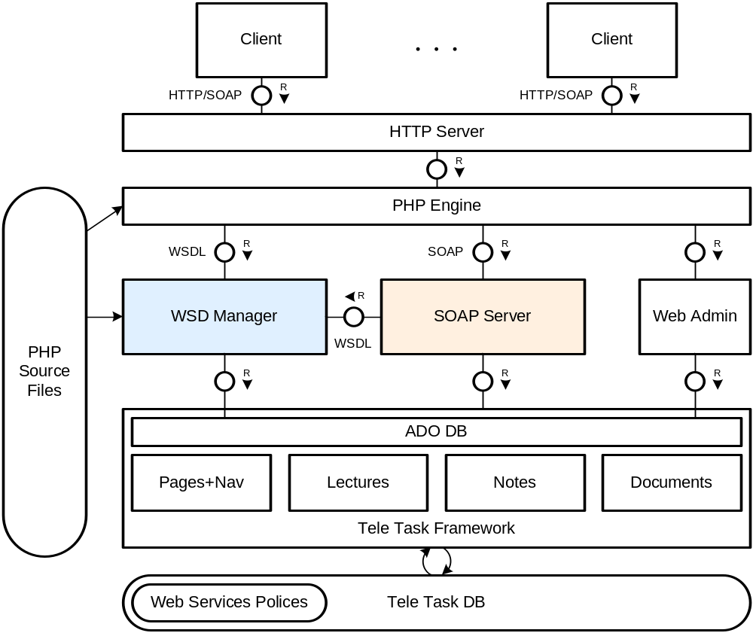
Architecture

Slide 5
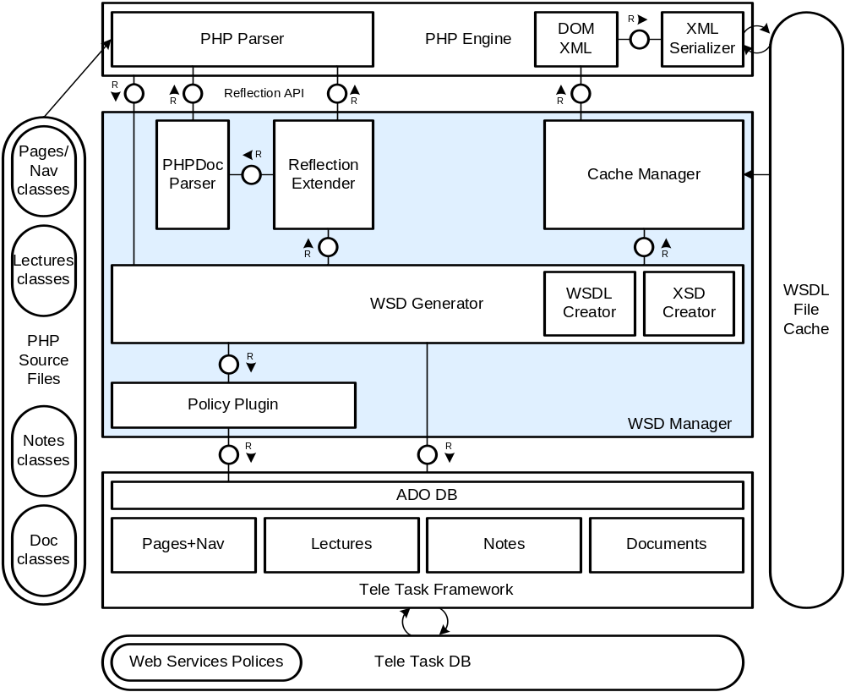
WSD Manager

Slide 6
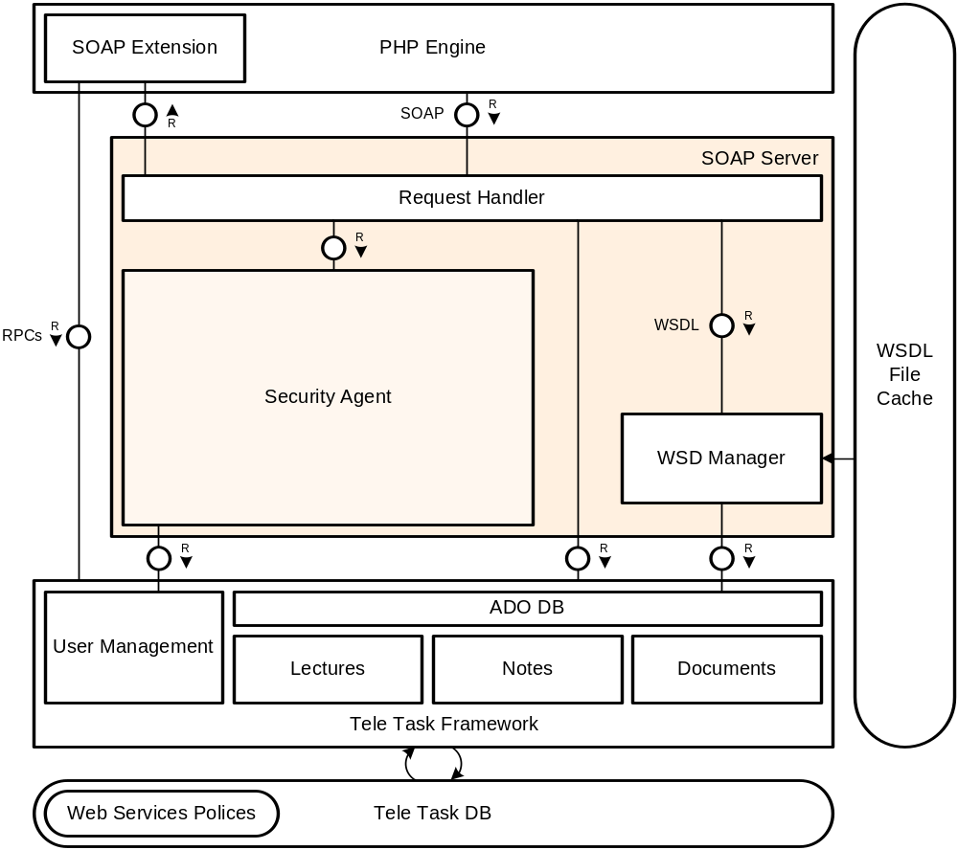
SOAP Server

Slide 7
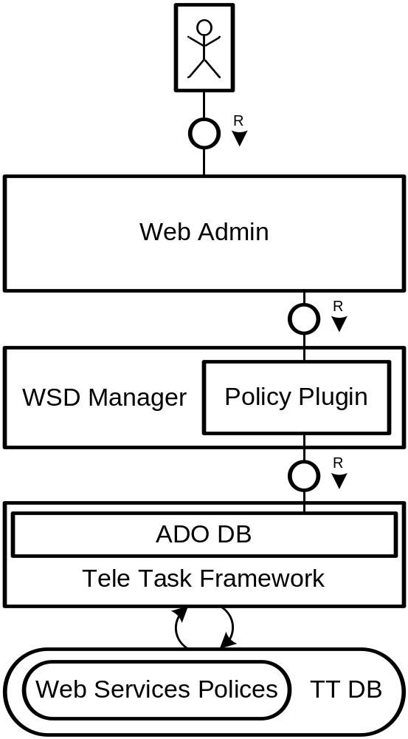
Web Admin Features
Set polices for provided web services
  Activate classes to provide Web Services
  Choose published methods
    Only public methods
Adjust documentation published in WSDL

Slide 8
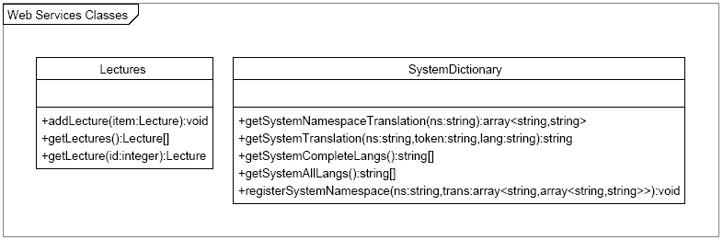
Constrains for this Approach
General expectations on classes intended to be used as
Web Services
Problem: inputs via SOAP are only plain objects with members, no methods

Slide 9
Status
Conceptual Design
Security Standards
  WSS Approach
  HTTP based
Generation of WSDL- and XSD-Files
  Extended Reflection API
Example Implementation
Documentation
  Style Guide

Slide 10
WSD Generator - PHP5 Reflection API
PHP5 provides complete reflection API
  reverse-engineer
    Classes
    Interfaces
    Functions
    Methods
    Extensions
  retrieve doc comments
object-oriented extension to Zend Engine
used to gather information for generate WSDL- and XSD-files

Slide 11
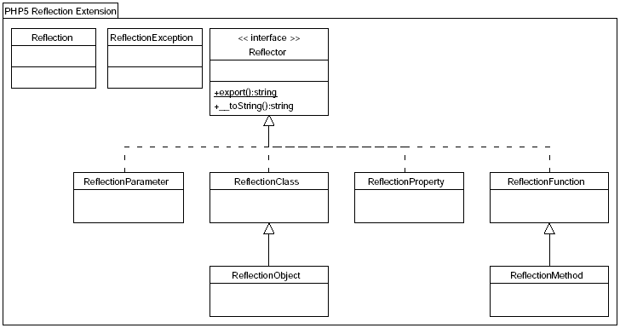
PHP5 Reflection API

Slide 12
Security Aspects
Web Service Facade for PHP5

Slide 13
Security: Aims
usage of security aspects independently from WSDL-files
prevent stateful webservices
general procedure
  a proxy catches the messages
  controls the security aspects
  forward the messages to a worker
implemented classes should be unattached by security aspects
implementation of two different possibilities
  Token Framework
  Username Token Profile 1.0

Slide 14
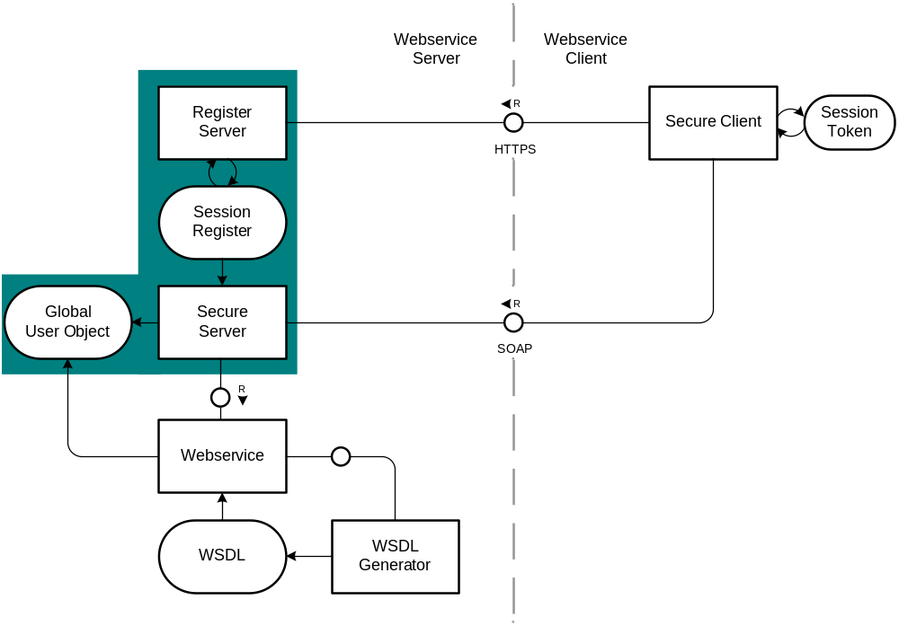
Security: Token Framework 1/2
General Information
  client connects to the register server and gets a token depending on username and password
  by the use of this token the access to the user’s functions is controlled
  usage of PHP sessions
  usage of cookies

Slide 15
Security: Token Framework 2/2
Advantages
  usage of existing standards
  stateful Web Services possible
Disadvantages
  plaintext
    counteractive measures
      SSL
      HTTPS
  stateful Web Service

Slide 16
Security: Username Token Profile 1.0 1/3
General Information
  implementation of parts of the OASIS Web Services Security (WSS)
  xml syntax:
  Password_Digest
  = Base64 ( SHA-1 ( nonce + created + password ) )
<wsse:Security>
  <wsse:UsernameToken wsu:Id="our-Example">
    <wsse:Username> Andreas </wsse:Username>
    <wsse:Password Type="...#PasswordDigest">
    weYI3nXd8LjMNVksCKFV8t3rgHh3Rw==
    </wsse:Password>
    <wsse:Nonce>
    WScqanjCEAC4mQoBE07sAQ== </wsse:Nonce>
    <wsu:Created> 2003-07-16T01:24:32Z </wsu:Created>
  </wsse:UsernameToken>
</wsse:Security>

Slide 17
Security: Username Token Profile 1.0 2/3
security considerations
  the secret is put at the end of the input an not the front
  replay attacks: using message timestamps, nonces and caching
  recommends against replay attacks:
    reject any UsernameToken using not both nonces and timestamps
    using timestamp freshness limitation and rejecting all UsernameToken with “stale” timestamps
    caching nonces for a period of time and rejecting all UsernameToken with already used nonces

Slide 18
Security: Username Token Profile 1.0 3/3
Advantages
  open standard (supported by IBM, SUN (java), …)
  independent of PHP, e.g. other clients with different programming languages can use it
  there are only ‘self-writing-alternatives’
Disadvantages
  Password_Digest valid for a specified time-frame
    counteractive measures: one-time nonce
  Possibly plaintext passwords

Slide 19
Coding Guidelines
Web Service Facade for PHP5

Slide 20
Coding and Style Guidelines
WSDL-files are necessary to define communication between Web Service Client and Server
  Interface specification of Web Service needed
Documentation is added to compensate the lack of datatype info
phpDocumentor-Tags:
  existing parsers can be used
  common standard
Enhanced readability and easier maintenance as a plus

Slide 21
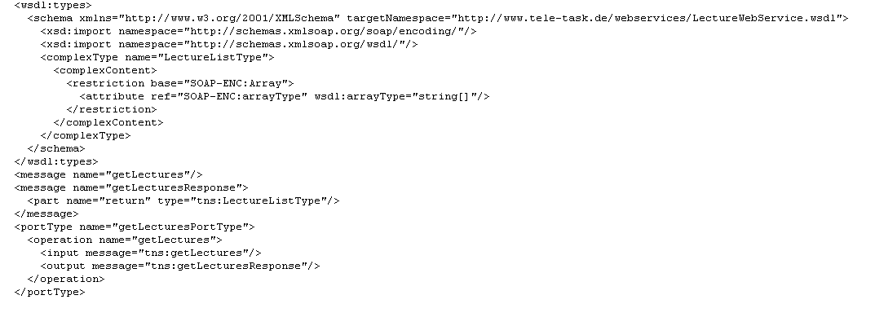
WSDL Example

Slide 22
General Guidelines
One header block comment per file
One comment per class, method or function
Short documentation for every variable
DocComments start with /** and end with */, beginning with a description followed by the DocTags
Maximum of 77 chars per line
CamelCase, avoid underscores

Slide 23
Datatype Declaration
Tags needed for WSDL Parser:
  @return datatype description
    States the datatype of the return value and additional information
  @var datatype description
    States the datatype and additional information for variables
  @param datatype $paramname description
    States the datatype and information for function arguments
  datatype may be
    Integer
    String
    Double
    Boolean
    AnyClass
    array of a datatype (string[], integer[], MyClass[], …)
    Associative arrays as: array<datatype,datatype>
  No mixed

Slide 24
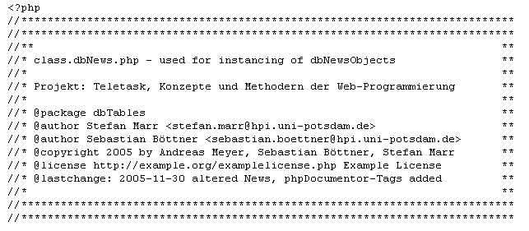
Header Block Comments
Short description
Optional long description
Project name
At least:
  @package @author @copyright @license @lastchange
Optional:
  @deprecated @internal @see @since @uses @version

Slide 25
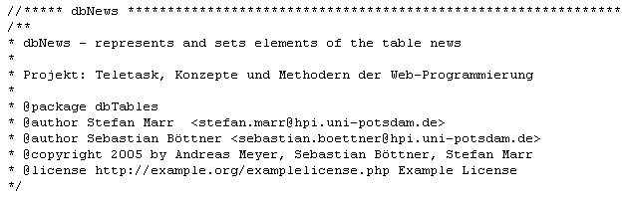

Classes and Attributes
Similar to Header Block Comments (same Tags)
  Optical differences for distinguishing
There must be one comment for each variable
  At least datatype must be present
  Description optional

Slide 26
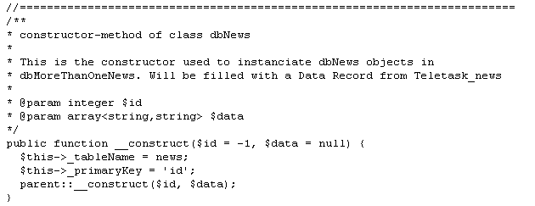
Methods and Functions
Short description
Optional long description
At least @param and @return must be present if existent
//end of functionName if method spans more than 15 lines

Slide 27
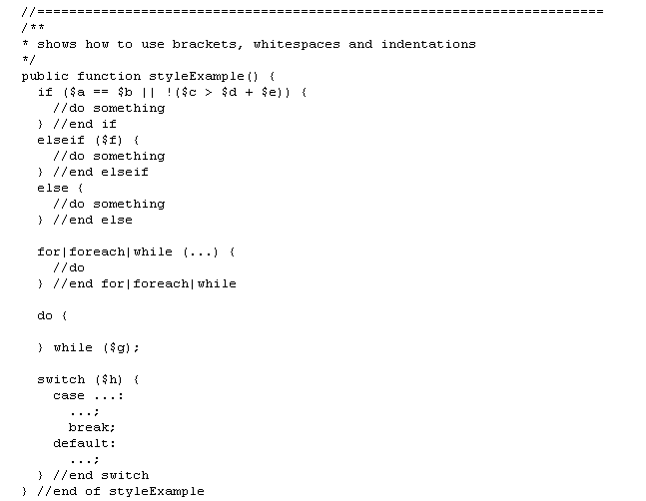
Control Structures
//end of structure comment if structure spans more than 15 lines

Slide 28
References
[UTP10] Web Services Security - UsernameToken Profile 1.0
OASIS Standard 200401, March 2004
http://docs.oasis-open.org/wss/2004/01/oasis-200401-wss-username-token-profile-1.0.pdf
[WSS11] Web Services Security: SOAP Message Security 1.1
Working Draft - 07 November 2005
http://www.oasis-open.org/committees/download.php/15251/oasis-wss-soap-message-security-1.1.pdf
[PHPMAN] PHP.net Manual
http://www.php.net/manual/en/ref.soap.php
http://www.php.net/manual/en/language.oop5.reflection.php
[PEAR] PEAR Coding Standards
http://pear.php.net/manual/en/standards.php
[PHPDOC] phpDocumentor tags How to use tags in DocBlocks
http://manual.phpdoc.org/HTMLSmartyConverter/HandS/phpDocumentor/tutorial_tags.pkg.html
[XSD] XML Schema Part 2: Datatypes Second Edition
http://www.w3.org/TR/xmlschema-2/
[JAVADOC] How to Write Doc Comments for the Javadoc Tool
http://java.sun.com/j2se/javadoc/writingdoccomments/
[STYLE] Style Guide
http://www.hpi.uni-potsdam.de/fileadmin/hpi/FG_ITS/lecturenotes/webprogrammierung/style_guide/index.html

Slide 29
WebService Facade for PHP5
Q & A

